Slide 1
FRAUD DETECTION
Presented By
Mrutyunjaya Sahoo

Slide 2
Agenda
Introduction
Problem statement
Objective
Data Exploration(Overview of data)
Exploratory Data Analysis (EDA)
Model Implementation
Conclusion
Business Recommendation

Slide 3
Introduction:
The rapid growth of mobile financial transactions has introduced significant challenges in ensuring transaction security. Fraudulent activities within these systems pose substantial risks, both financially and reputationally, to businesses and consumers alike.
This project leverages a dataset containing crucial transaction details, such as transaction type, amounts, and account balances, to develop a model aimed at detecting fraudulent transactions. By analyzing these features, our objective is to create an effective fraud detection system that minimizes financial losses and enhances the integrity of mobile financial services.

Slide 4
Problem statement:
The primary objective of this project is to enhance the accuracy of fraud detection in mobile financial transactions. By utilizing machine learning, we aim to predict fraudulent transactions with a high degree of precision. Our goal is to develop a robust model that can identify fraudulent activities in real-time, thereby improving transaction security, minimizing financial losses, and providing valuable insights into the underlying factors that contribute to fraud.

Slide 5
Objective:
Developing a machine learning model that can accurately predict fraudulent mobile financial transactions, thereby minimizing financial losses and improving overall security.

Slide 6
Data Exploration(Overview of data)
Step: This represents the time unit of the transaction. The range is between 1 and 95, with a mean of 8.72 and a standard deviation of 16.07. Most transactions occur early in the timeframe.
Amount: Transaction amounts vary widely, ranging from 2.39 to 10 million, with an average transaction amount of approximately 213,192 and a standard deviation of 760,065, indicating large variability in transaction sizes.
Old Balance Origin (oldbalanceOrg): The origin account's balance before the transaction ranges from 0 to 19.9 million, with a mean of 924,117 and a high standard deviation, signifying significant variation in account balances.
New Balance Origin (newbalanceOrig): Post-transaction origin account balances range from 0 to 13 million, with a mean of 824,958. Many accounts show a significant reduction in balance after transactions.
Old Balance Destination (oldbalanceDest): Destination account balances before the transaction range from 0 to 33 million, with many zero balances as the 50th percentile is 0. This indicates many transactions are sent to new or inactive accounts.
New Balance Destination (newbalanceDest): After the transaction, destination account balances range from 0 to 34.6 million, with a mean of 1.1 million. A large portion of transactions result in accounts receiving significant amounts.
Is Fraud: The target variable shows a mean of 0.102, indicating that about 10.25% of the transactions in the dataset are fraudulent.

Slide 7
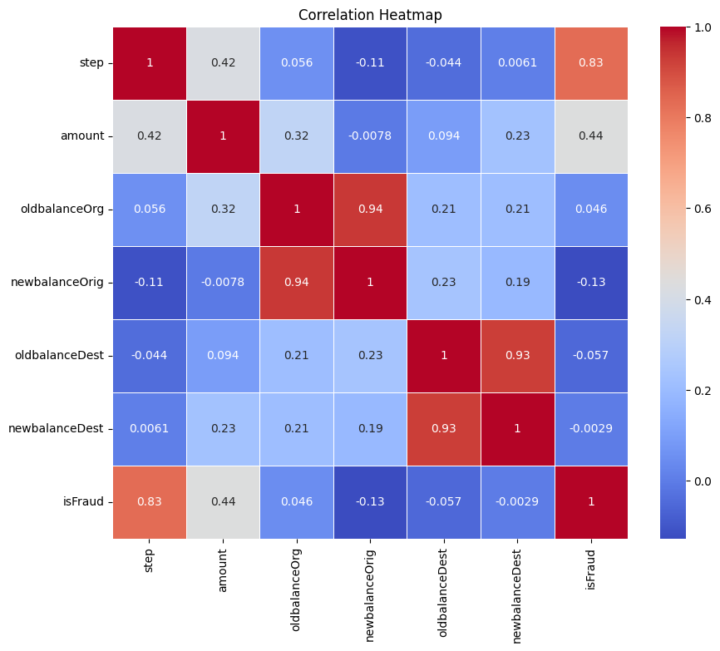
Exploratory Data Analysis(EDA) Correlation Analysis:
oldbalanceOrg and newbalanceOrig: A very strong positive correlation (0.94) indicates that the original balance before and after a transaction are closely linked. This is expected as most transactions wouldn't drastically alter the overall balance.
oldbalanceDest and newbalanceDest: Similarly, a strong positive correlation (0.93) exists between the destination account's balance before and after a transaction, suggesting a similar pattern.
amount and newbalanceDest: A moderate positive correlation (0.23) suggests that larger transaction amounts tend to result in higher ending balances in the destination account. This makes sense as more money transferred would increase the recipient's balance.
Most other pairs of variables show weak or negligible correlations. This suggests that other factors don't have a strong linear relationship with the account balances or transaction amounts.
Notes:
Exploratory Data Analysis (EDA)

Slide 8
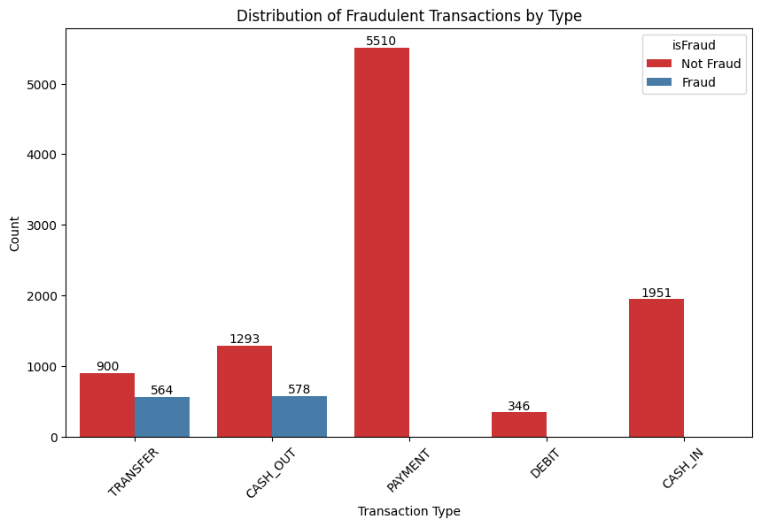
Distribution of Transaction Types
Fraudulent transactions majorly occur in "CASH_OUT" and "TRANSFER" types.
No fraudulent transactions are observed in "CASH_IN,"DEBIT" or "PAYMENT" types. These transaction types are less susceptible to fraudulent behavior.

Slide 9
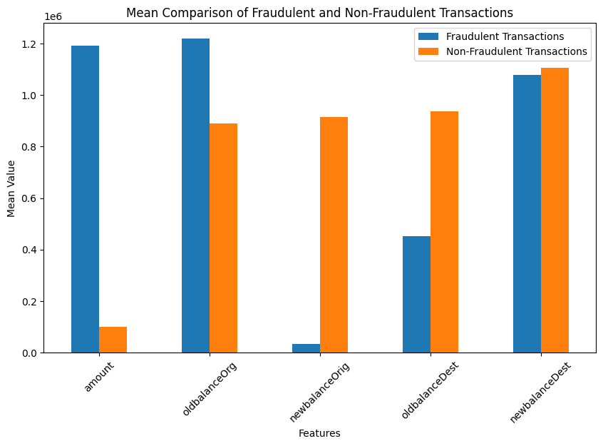
Mean Comparasion of Fraud and Non-Fraudulent Transaction
Higher Transaction Amounts in Fraudulent Cases: Fraudulent transactions have a significantly higher mean amount compared to non-fraudulent transactions. This aligns with previous observations that fraudsters tend to target larger transactions.
This analysis highlights key differences in the average values of transaction amounts and account balances between fraudulent and non-fraudulent transactions. These insights can be valuable for developing fraud detection models and strategies.

Slide 10
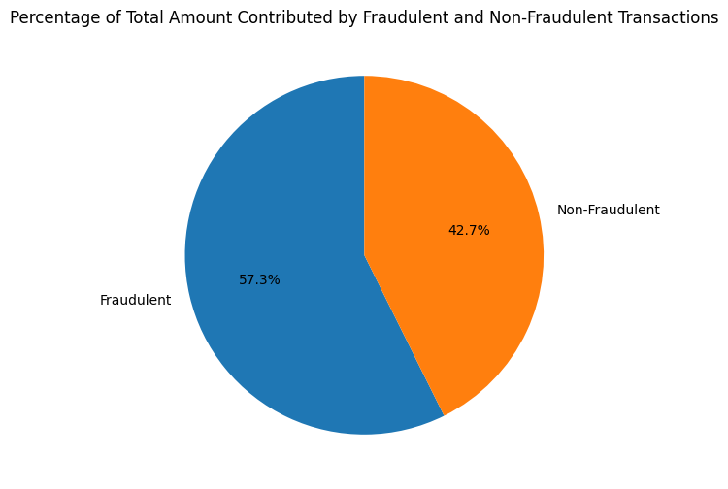
Percentage Analysis of Fraudulent And Non-Fraudulent Transaction
Fraudulent Transactions: These transactions account for a substantial 57.3% of the total amount contributed. This suggests that fraudulent activities are a major concern, potentially impacting financial systems and businesses.
Non-Fraudulent Transactions: While still contributing a significant portion of 42.7%, non-fraudulent transactions are outpaced by fraudulent ones. This indicates a need for improved fraud detection and prevention measures.

Slide 11
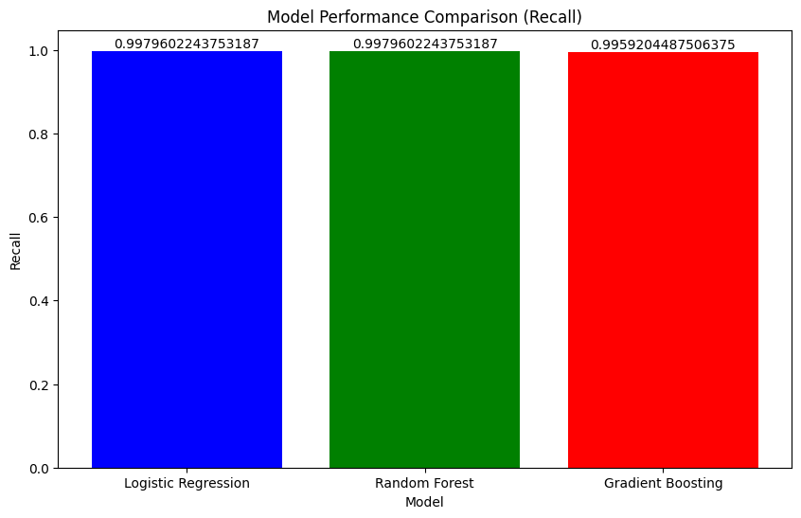
Comparasion of Models:
Logistic Regression: Achieves the highest recall value of 0.9996, indicating excellent performance in identifying positive instances.
Random Forest: Also performs well with a recall of 0.9996, demonstrating similar sensitivity to Logistic Regression.
Gradient Boosting: While still achieving a high recall of 0.9959, it is slightly behind Logistic Regression and Random Forest.

Slide 12
Conclusion
Prevalence of Fraud: The pie chart indicates that fraudulent transactions contribute a substantial portion to the total amount contributed, highlighting the need for effective fraud detection and prevention measures.
Model Performance: The bar chart demonstrates that machine learning models, such as Logistic Regression and Random Forest, can achieve high recall rates in identifying fraudulent transactions. This suggests their potential effectiveness in detecting and preventing fraudulent activities.

Slide 13
Business Recommendation:
Advanced Fraud Detection Systems Machine Learning: Utilize ML models for pattern recognition and anomaly detection.
AI-Powered Solutions: Implement AI tools for real-time monitoring and adaptive fraud detection and Enhanced Data Security Encryption
Regular Audits: Conduct frequent security audits and Educate employees on data security best practices.
Customer Education Fraud Awareness Campaigns: Educate customers about common fraud tactics, Phishing Prevention, Promote secure online behavior
3. Strong Authentication Measures Multi-Factor Authentication: Require multiple forms of identification, Biometric Authentication, Password Updates: Encourage regular password changes.
Industry Collaboration Information Sharing: Exchange information with industry partners, Regulatory Compliance: Ensure compliance with relevant regulations.

Slide 14
Questions ?

Slide 15
Thank You!

